Slide 1
Physical computing: control servos, LEDs and more from Scratch using RPi, Arduino, scratchClient
Hans de Jong
Pi And More 9½
Krefeld – 14 January 2017

Slide 2
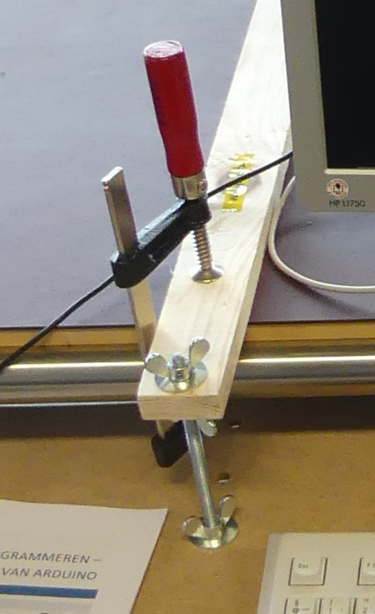
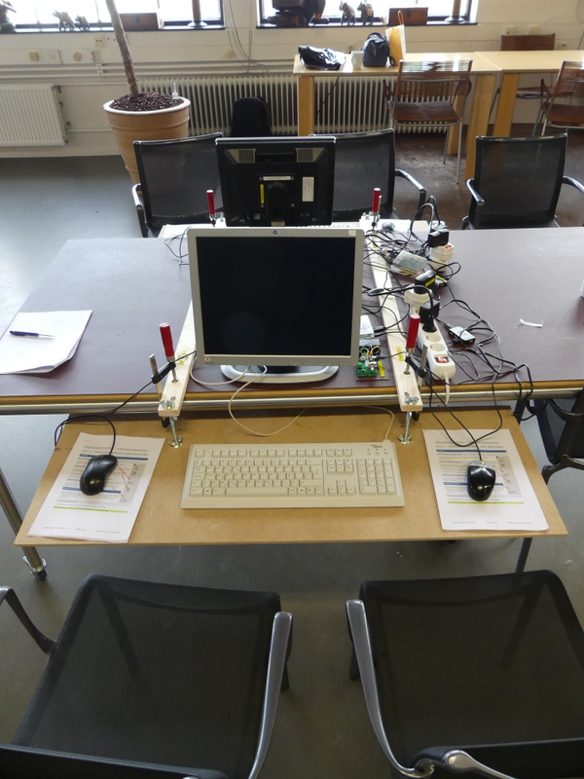
Ergonomics
At the Weekendschool we teach children 5 golden rules how to sit when using computers:
Rest your arms on the table in a natural fashion.
If you do not need the keyboard, move it up and give room to the mouse.
Have the monitor at arms length.
Change position (lean forward, backward etc.).
Frequently stop, walk around and excersize.
To change the height, use the two upper wingnuts.

Slide 3
Workshop organisation
Welcome and introduction presentation (10 min).
After that everyone will work at his or her own pace.
At times we will present for 5 minutes to explain a next concept.
Language: English, but help in German available.
At the end copy to your USB stick (if you want) and cleanup.
The major steps:
Get a working hardware and scratchClient config using a Scratch test program.
Update scratchClient config (moving to other GPIO pins)
Write your own Scratch program to access the board.
Add more hardware (buzzer, tri-color LED, button, joy stick) and adapt scratchClient config and adapt the Scratch program.
If you want: have a look at the game used at the Weekendschool and program a bit yourself.
Start latest 30 minutes before the end of the workshop.

Slide 4
Objectives
At the end of today you should be able to:
Reproduce the setup at home (provided you have the hardware ☺ )
Understand
Digital output (e.g. lighting a LED)
Digital input (e.g. sensing a button)
Analog input (e.g. from a potentiometer)
Pulse Width Modulation (PWM)
for dimming LEDs
For controlling servos
For controlling a buzzer
Understand what all the resistors are for
Be able to configure and run scratchClient
Program Scratch to control the physical input and output
If time permits / as you desire: look at a game using servos, buttons, LEDs etc. as used on the Weekendschools in The Netherlands.
Have fun!

Slide 5
Non-objective
It is not an objective to create a complete useful game or other program.
You can do that with your own creativity at home now that you know how to control several pieces of hardware from Scratch using scratchClient.

Slide 6

Weekendschool
Generally parents tell their children: “Learn for later”. But what is later?
“I want to become an engineer. Do you maybe know an engineer? I would very much like to meet one”
Professionals teach children on Sundays about their job. Large variety of topics.
> 1000 students between 11 and 14 years from underprivileged areas.
Curriculum lasts for 2.5 to 3 years
3500+ volunteers.
Funded by 110+ sponsors (companies, individuals, foundations).
Started in 1998.
It works! Data shows: alumni have better professional prospects, are more self-aware, and feel more connected with society.
EINDHOVEN 58 students
IMC Weekendschool
Trudo Weekendschool

Slide 7
Lessons at the Weekendschool
I personally teach
Mathematics (since 12 years)
Physics (since some 6 years)
Programming (started this 2016)
Electro (started this 2016)
Programming: 3 lessons on 3 Sundays with Scratch, Raspberry Pi and Arduino
Lesson 2: Physical computing: https://youtu.be/Qo1gnXNzhqE

Slide 8
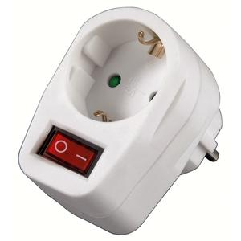
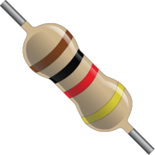
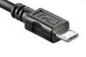


Only a few rules
If Raspberry Pi needs to be rebooted, it needs a powercycle. Please do not pull plugs but use the switch in the outlet.
Always put a resistor in series with the components
If you think there is no need then please tell us and we will explain what the reason is (with one exception).
When changing the wiring
Stop scratchClient (just close the window)
Detach the USB cable from the Arduino Nano
Switch off the 9V power
Check, double check and check again whether the wiring is correct. You may blow up components when wiring wrongly.
Make sure that you both (4 eyes principle) are convinced the wiring is OK before turning on power again.
If something breaks down or gets damaged: we have some spare material
Do not put anything that is broken back into the box please.

Slide 9
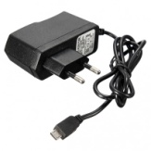

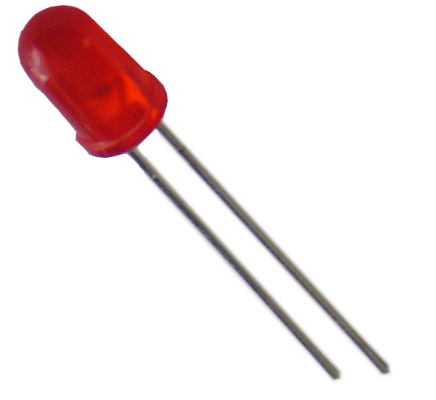
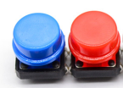


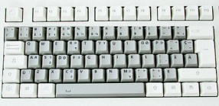
The setup
Raspberry Pi
2B or 3B
Powered USB hub
(not strictly needed since Arduino is powered separately – used for protection of RPi)
Arduino Nano
Scratch 1.4 run time
scratchClient
scratchClient Sketch
Remote Sensor Protocol Over socket 42001
Global variables
Broadcasts
Program in Scratch
Predefined sprites (with some code, sounds and costumes)
scratchClient Config file
Defines function of the GPIO pins on the Arduino (and RPi) and gives them logical names.
Standard setup
Programmed by the students
Prepared by the teacher

Slide 10
What do you have at your desk?

Slide 11
Where is the presentation?
You will find this presentation = the instruction at your desktop in PiAndMore/Part-1--Breadboard
If you already know the stuff and get bored then feel free to work on your own
Silently please … ☺

Slide 12
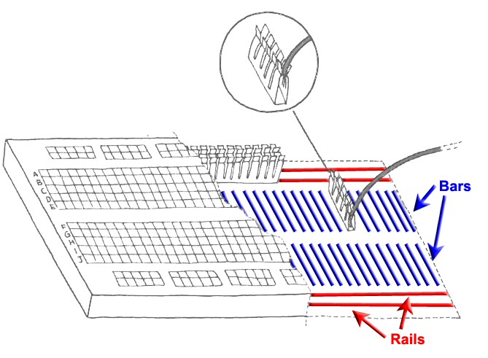
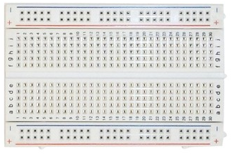
Breadboard
Used to quickly build electronic circuits
Note the 2 rails for + (VCC) and – (GND)
Note the 2 bars with 5 interconnected holes each.

Slide 13
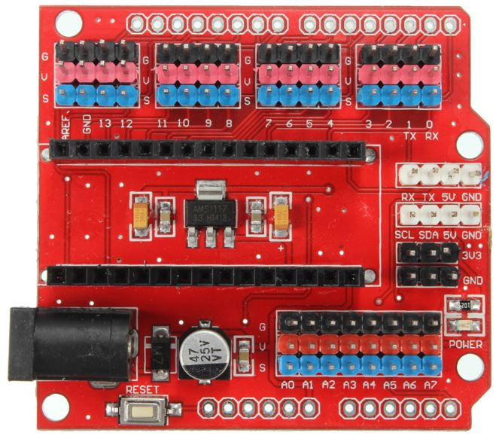
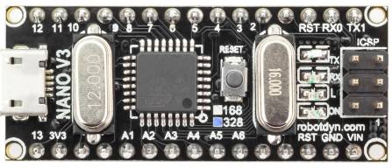
Looking at the Arduino Nano extension board
Analog ports
Reset button
Per GPIO signal 3 headers:
S (blue = signal)
V (red = VCC = +)
G (black = GND = -)
(very handy to e.g.
connect servos)
9V power socket
Arduino Nano with 328P processor
Micro USB port
Reset button
Digital ports

Slide 14
Uploading scratchClient to the Arduino

Slide 15
Looking at the scratchClient config file

Slide 16
The first thing – as always
Get the “Hello World” experience
Get something working so that you see it is worth continuing

Slide 17
Digital Output

Slide 18
Digital Input

Slide 19
Analog input

Slide 20
Pulse Width Modulation (PWM)

Slide 21
Controlling a servo with PWM

Slide 22
Dimming a LED with PWM

Slide 23
Expanding

Slide 24
Tri-color LED with PWM

Slide 25
Control a passive buzzer with PWM

Slide 26
Add a Joystick

Slide 27
More information
This presentation, source files of the game and workshop material
www.github.com and search for Weekendschool or for PiAndMore
scratchClient
http://heppg.de/ikg/wordpress/?page_id=6
Scratch
https://scratch.mit.edu/
Scratch on Raspberry Pi
https://www.raspberrypi.org/forums/viewforum.php?f=77
Raspberry Pi
https://www.raspberrypi.org/
Arduino
https://www.arduino.cc/

